Slide 1
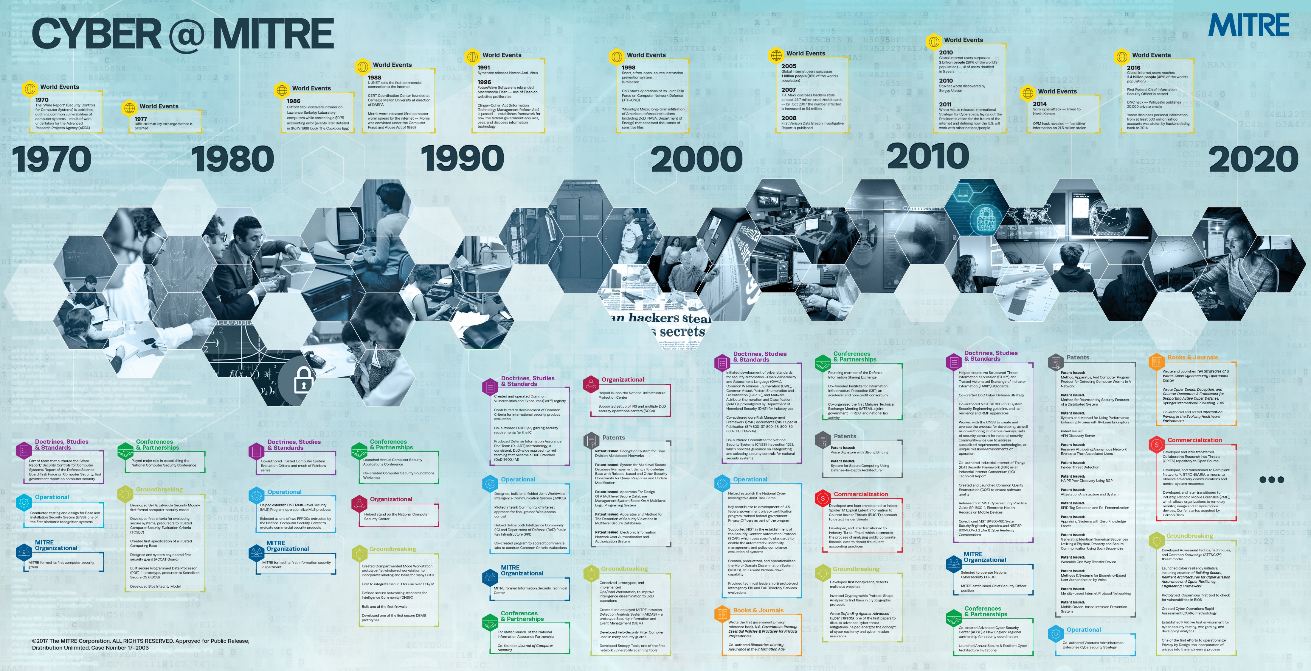
50
YEAR CELEBRATION
1

Slide 2
MITRE’s Cyber Capabilities
Engineering & Architecting Safe, Secure, Resilient Systems
Cyber Assessments
Enterprise Security Architecture
Security Automation and Mgmt
Cyber Safety
Cyber Resiliency
Privacy Engineering
Cyber Strategy and Governance
Cloud Security
Data Security
IoT and Cyber Physical Systems
Trust and Assurance
Advancing Cyber Technologies
Cross Domain Solutions
ICAM
Mobile Security
Cybersecurity Operations Centers
Cyber Effects and Reverse Eng
Cyber Forensics
Cyber Threat Intel and Sharing
Cyber Operations and Effects
Cyber Adversary Emulation
Cyber Analytics and Malware
Cyber Deception and Adversary Engmt
Deliver innovative and high-impact cyber capabilities essential to sponsor missions

